Slide 1
DLD Online 1
Section A1 & B1

Slide 2
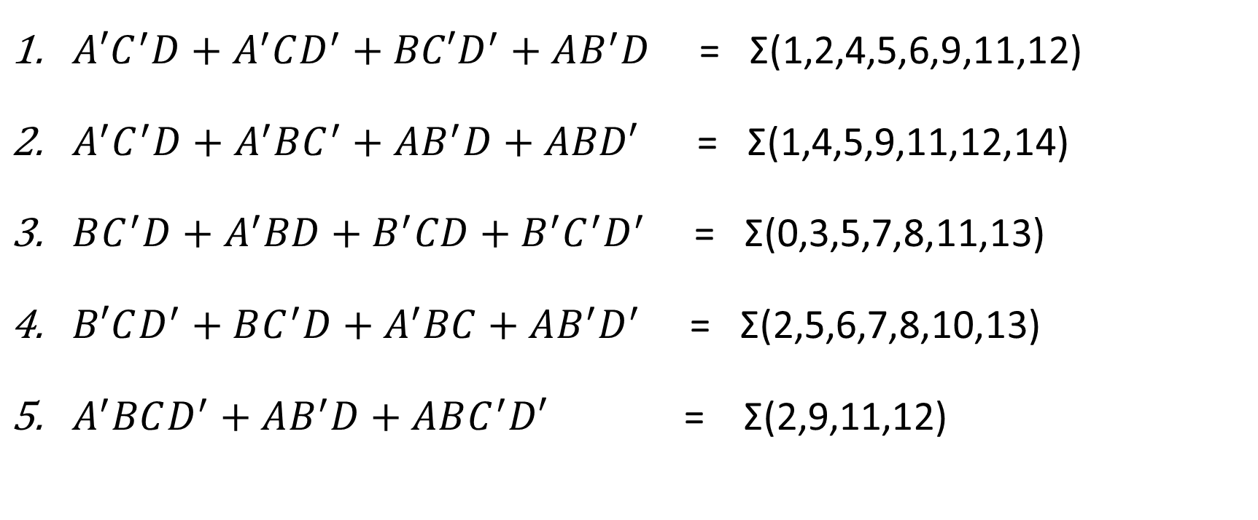
Consider there are four 1-bit Boolean inputs A,B,C and D. Implement the following Boolean functions using only the 7400-series IC chips: IC 74x04, IC 74x08 and IC 74x32 in your circuit.
Time: 30 minutes + 5 Minutes to submit in Moodle.
${A′C}^{′}D+A^{′}CD^{′}+BC′D^{′}+AB^{′}D$ = Σ(1,2,4,5,6,9,11,12)
$A^{′}C^{′}D+A^{′}BC^{′}+AB^{′}D+ABD′$ = Σ(1,4,5,9,11,12,14)
$BC^{′}D+A^{′}BD+B^{′}CD+B^{′}C^{′}D^{′}$ = Σ(0,3,5,7,8,11,13)
$B′CD^{′}+BC^{′}D+A^{′}BC+AB^{′}D^{′}$ = Σ(2,5,6,7,8,10,13)
$A^{′}BCD^{′}+AB^{′}D+ABC^{′}D′$ = Σ(2,9,11,12)

